Slide 1
HUMAN COMPUTER INTERACTION
LECTURE 2

Slide 2
Input-Output channels:
A persons interaction with the outside world occurs through information being received and sent.
Input in human occurs mainly through senses and output through the motor control of the effectors.
Here are five senses
Sight
Hearing
Touch
Taste
Smell
The first three are the most important to HCI

Slide 3
Vision:
Human Vision is a highly complex activity with a range of physical and perceptual limitations, yet it is the primary source of information.
Visual perception is divided into two stages-The physical reception of the stimulus from the outside world, and the processing interpretation of that stimulus.
We need to understand both stages as both influence what can and what cant be perceived visually by a human being, which is turn directly affects the way that we design computer systems.

Slide 4
Human eye-Vision begins with light. The eye is a mechanism for receiving light and transforming it into electrical energy.
Light is reflected from objects in the world and their image is focused upside down on the back of the eye. The receptors in the eye transform it into electrical signals which are passed to the brain.
The retina of the eye is light sensitive and contains two types of photo receptors : Rods and Cones.
Rods are highly sensitive to light and therefore allow us to see under a low level of illumination.
Cones are the second type of receptor in the eye. They are less sensitive to light than the rods and can therefore tolerate more light.
There are three types of cone, each sensitive to a different wavelength of light. This allows color vision.

Slide 5
Visual Perception:
Understanding the basic construction of the eye goes somewhere to explaining the physical mechanism of the vision but physical perception is more than this.
The information received by the visual apparatus must be filtered and passed to processing elements which allow us to recognize coherent scenes, disambiguate relative distance and differentiate color.
Perceiving size and depth – Eye perceive size, depth by considering how the image appears on the retina. The size of the image is specified as visual angle.
If we draw a line from the top of the object to a central point on the front of the eye and second line from the bottom of the object to the same point, the visual angle of the object is the angle between these two lines.
Visual angle is affected by both the size of the object and its distance from the eye.

Slide 7
Perception of size – Visual angle of object is reduced as it gets away, we might expect that we would perceive the object as smaller.
In fact, our perception of an object size remains constant even if its visual angle changes.
So a person height is perceived as constant even if they move far from you.
This is the law of size constancy and it indicates that our perception of size relies on factors other than visual angle.
Perception of depth – If objects overlap, the object which is partially covered is perceived to be in the background and therefore far away.
Similarly the size and height of the object in our field of view provides a hint of its distance.
If we expect an object to be of a certain size then we can judge its distance accordingly

Slide 8
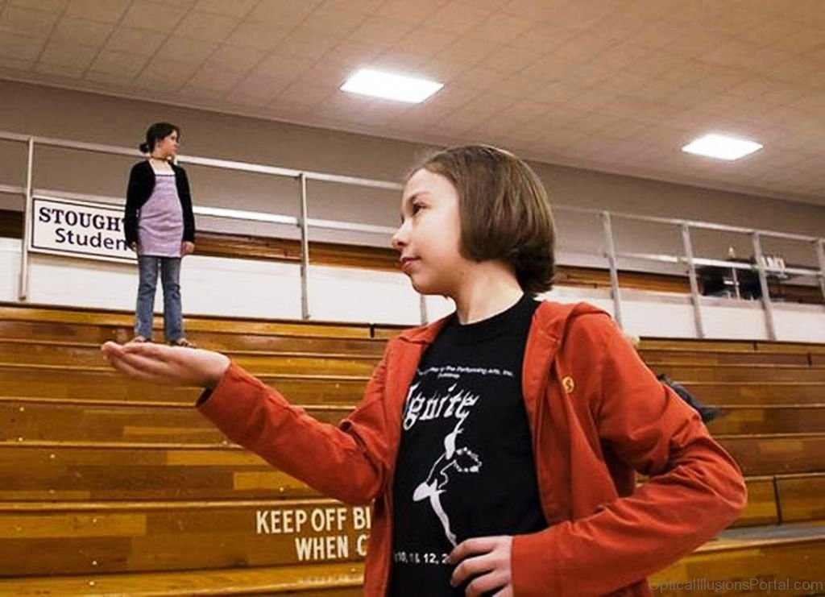

Slide 9
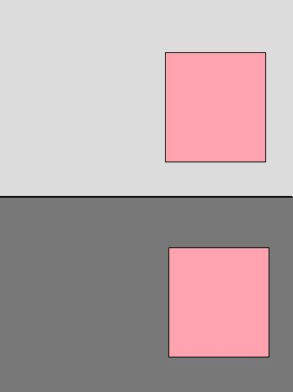
Perceiving Brightness – Brightness is in fact a subject to reaction to levels of light. It is affected by luminance which is the amount of light falling on the object surface and its reflective properties.
Contrast is relative to luminance it is a function of the luminance of an object and the luminance of its background. Visual activity increases with increased luminance.

Slide 10
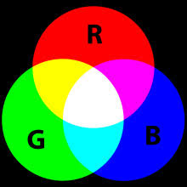
Perceiving Color –Color is usually regarded is being made up of three components: hue, intensity and saturation.
Hue is determined by the spectral wavelength of light.
Blues have short wavelength ,green medium and red long.
Intensity is brightness of color and saturation is the amount whiteness in the color.
By varying these two, we can perceive seven million different colors.
However, the number of colors that can be identified by an individual without training is very few.

Slide 11
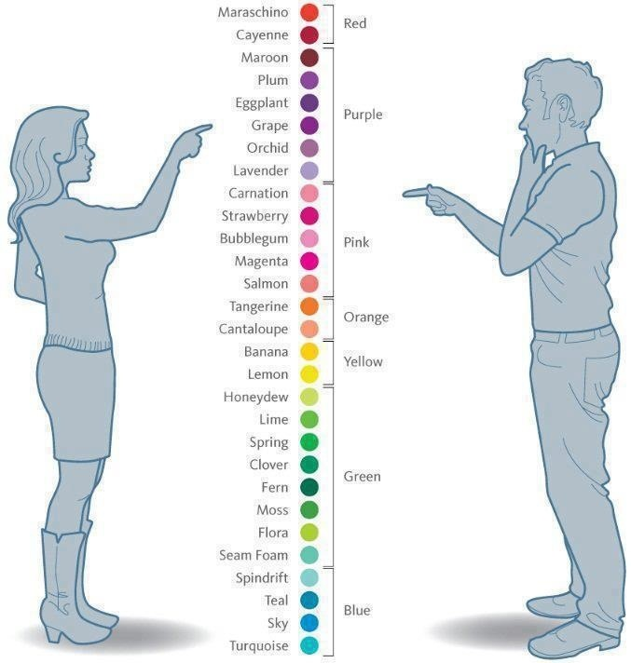

Slide 12
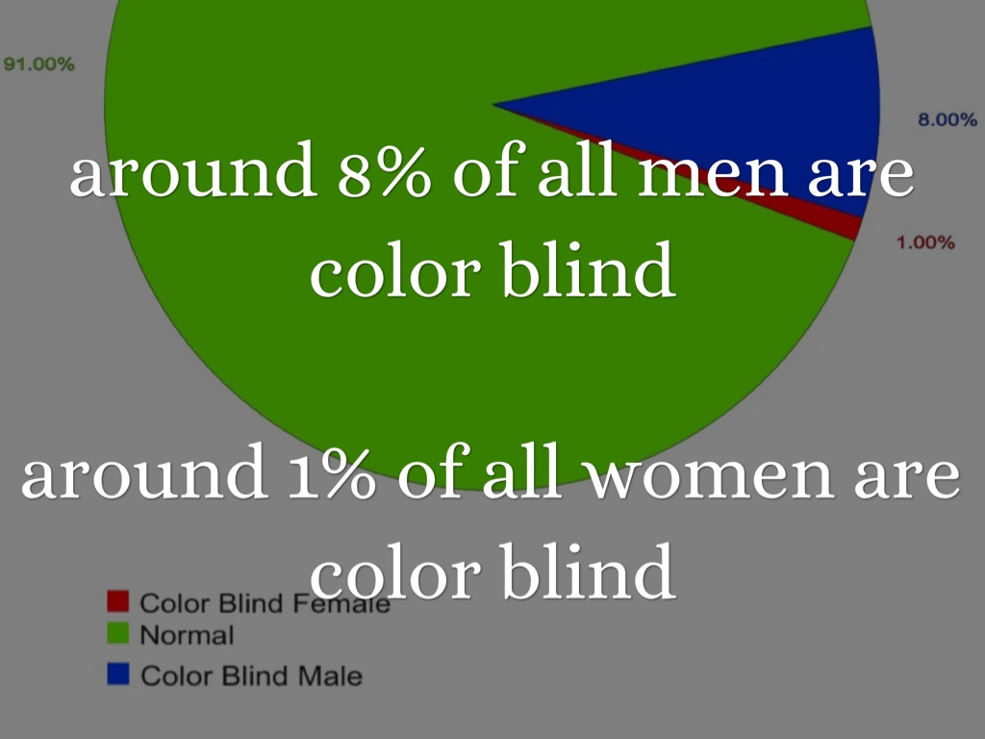

Slide 13
Hearing-the sense of hearing is often considered secondary to sight but we tend to underestimate the amount of information that we receive through ears.
Hearing begins with vibrations in the air or sound waves.
The ear receives their vibrations and transmits them through various stages, to the auditory nerves.
Sound is changed or vibrations in air pressure.
It has number of characteristics which we can differentiate.
Pitch is the frequency of the sound. A low frequency produces low pitch. A high frequency produces high pitch.
Loudness is proportional to the amplitude of the sound , the frequency remains constant.

Slide 14
Timbre relates to the types of the sound: sound may have same pitch and loudness but be made by different instruments and so vary in timbre.
Location of sound can be identified since the two ears receive slightly different sound, owing to the time difference between the sound reaching the two ears and the reduction in intensity caused by the sound waves reflecting from the head.
The human ear can hear frequencies from above 20HZ to 15KHZ.
The auditory system performs some filtering of the sounds received , to ignore background noise and concentrate on important information.
Sound can convey a remarkable amount of information but rarely used to its potential in interface design.
The ear can differentiate sound changes and can recognize familiar sounds without concentrating attention on the sound source.
This suggests that sound could be used more extensively in interface design.

Slide 15
Touch – The third and last of senses important for HCI is Touch or haptic perception. Touch is an important means of feedback and is needed in using computer systems.
Feeling buttons depress is an important part of the task of pressing button.
For average person, haptic perception is a secondary source of information but those whose often senses are impaired, it may be more important.
For such users, interfaces such as braille may be the primary source of information in the interaction.
In Haptic perception, we receive stimuli through the skin
The skin contains three types of sensory receptor: Thermoreceptors-respond to heat and cold, non receptors respond to intense pressure, heat and pain and mechanoreceptors respond to pressure.
It is the last of these that we are concerned with in relation to HCI.

Slide 16
There are two kinds of mechanoreceptors which respond to different type of pressures.
Rapidly adapting mechanoreceptors respond to immediate pressure. These receptors also react more quickly with increased pressure.
Slowly adapting mechanoreceptors respond to continuously applied pressure.
Although the whole body contains such receptors, some areas have greater sensitivity than others. The figures and thumbs have the highest sensitivity.

